Slide 1
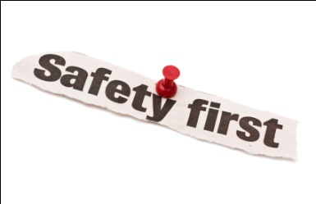
Occupational safety considerations on sites
Sedzani Elia Muravha
23-02-2012

Slide 2
Contents
Introduction................................................................................ 3
Relevant legislation................................................................... 3
Personnel.................................................................................... 4
Risk assessment......................................................................... 6
Typical hazards on sites............................................................
Accidents by human errors........................................................
Clothing ....................................................................................
Symbols.....................................................................................
Public liability...........................................................................
Emergency preparedness..........................................................
Conclusion.................................................................................
References.................................................................................

Slide 3
Introduction
Working on sites requires what?
Understanding and Knowledge
Risk assessment Maintenance
Relevant Legislation
Training
Safety Precaution
Emergency preparedness

Slide 4
Relevant legislation
Occupational health and safety act
Excavations are bounded by the Occupational Health and Safety Act, 1993 (Act 85 of 1993) and the Construction Regulations (Code of practice 2007).
Section 8 of the Occupational Health and Safety Act in Sub-section (1) which states that every employers should provide a safety, healthy and non-risky working environment to their respective employees (Code of practice 2007).
R13(2) under Construction Regulation 2003 clearly states that all employers in building sites should not permit their respective employees to work under unsupported roof (Code of practice 2007).
The Department of Labour- inspection and Enforcement Department administrate the Act and the Regulation (Code of practice 2007).

Slide 5
Relevant legislation
Specific requirements in the Construction Regulations
Regulation 11 Sub-section (2) states that the stability of the ground or working site should be evaluated before excavation starts (Code of practice 2007).
Regulation 11 Sub-section (3)(a) states that precautions should be taken to avoid employees from being trapped or buried by unstable falling ground (Code of practice 2007).
Regulation 11 Sub-section (3)(l) states that in all excavations where people work, the warning signs should be positioned adjacent to each excavation (Code of practice 2007).
Regulation 5 of the General Safety Regulations [R11(3)(j)] requires air in any working site to be tested and evaluated by a competent person to certify the safety during time of work (Code of practice 2007).

Slide 6
Personnel
Duties of employers towards personnel
All employers should know, understand and comply with the relevant legislations.
Duties include:
Qualifications
Trainings
Relevant experience
Protective equipments
Employer should ensure that all job activities are covered by insurance and all injuries are covered by the Occupational Injuries and Diseases Act, 1993 (Act 130 of 1993) (Code of practice 2007).

Slide 7
Personnel
Duties of personnel towards the employers
Duties include:
Check their insurance policies
Report any unsafe conditions
Refuse working or entering in any unsafe sites
Training of a personnel
Training should include (Code of practice 2007).:
Legislative requirements
Responsibilities and limits of responsibility
Awareness of potential hazards associate with work in test holes
Recognition of potentially dangerous situations and unstable soil conditions
Use of safety equipment

Slide 8
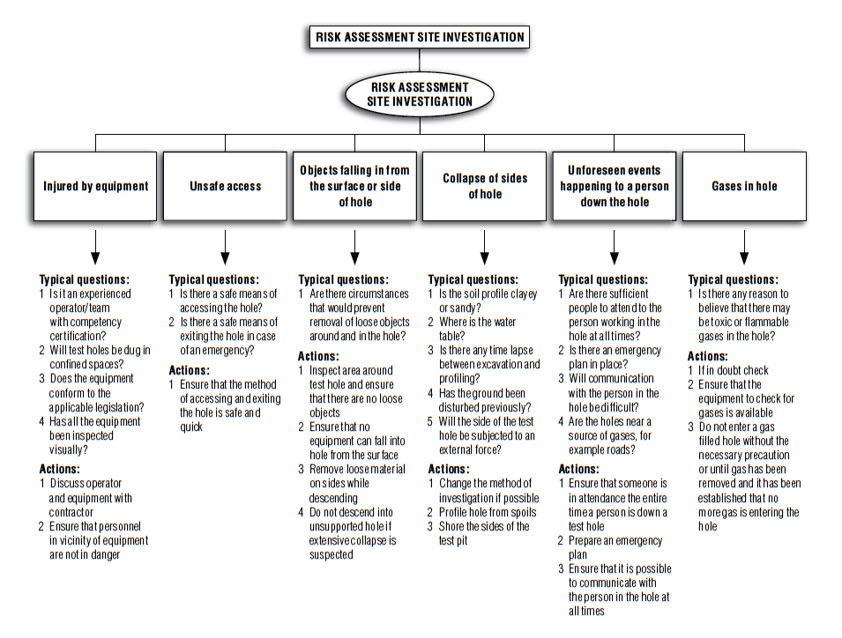
Risk assessment

Slide 9
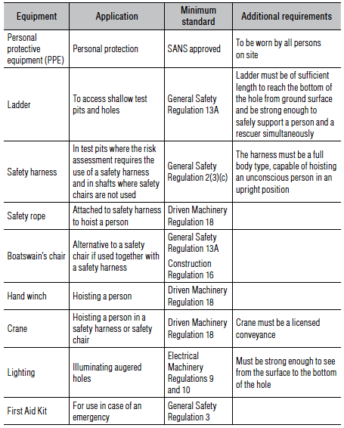
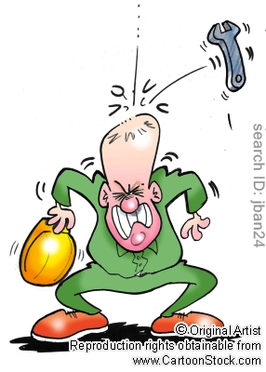
Typical hazards on sites
Plant and equipments
Be responsible
Table1 List of typical equipment and minimum standards (Code of practice 2007).

Slide 10
Typical hazards on sites
Lifts .....................................................................
Storage tanks......................................................
Electricity...........................................................
Leaks.................................................................
Fire precautions……………………………
Pipes and vessel failure

Slide 11
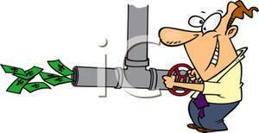
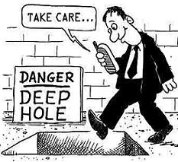
Accidents by human errors and mistakes
Forget to close a valve
Close the wrong valve
Wrong Valve Opened
Poor Layout of Instructions
Wrong labeling
Be responsible

Slide 12
Clothing
Helmet (SANS 1397)
Helmets should have a shell and a harness
Helmets should not harm or cause irritations
Glasses (SANS 1191)
Glasses should be free from defects which can interfere with the vision
Hearing Protectors SANS (1451-3)
Ear-muffs should not harm or cause any discomfort
Boots (SANS 1114)
Rubber or plastic coated boots with safety toe-caps for protection against impact and tested at an energy level of 200J

Slide 13
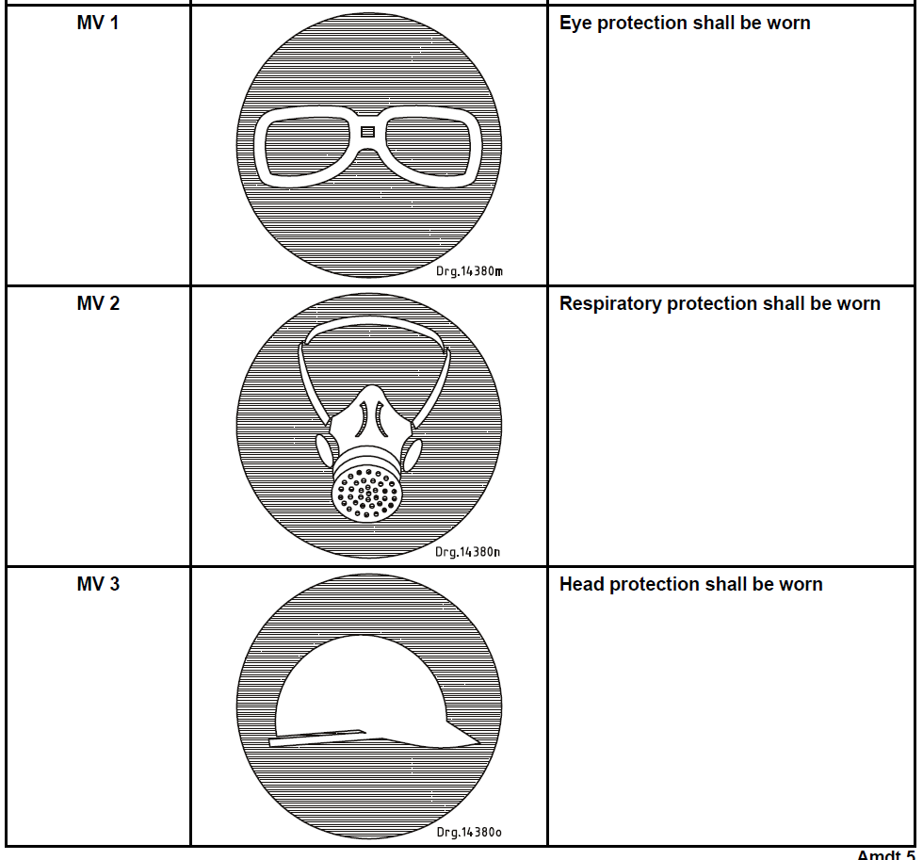
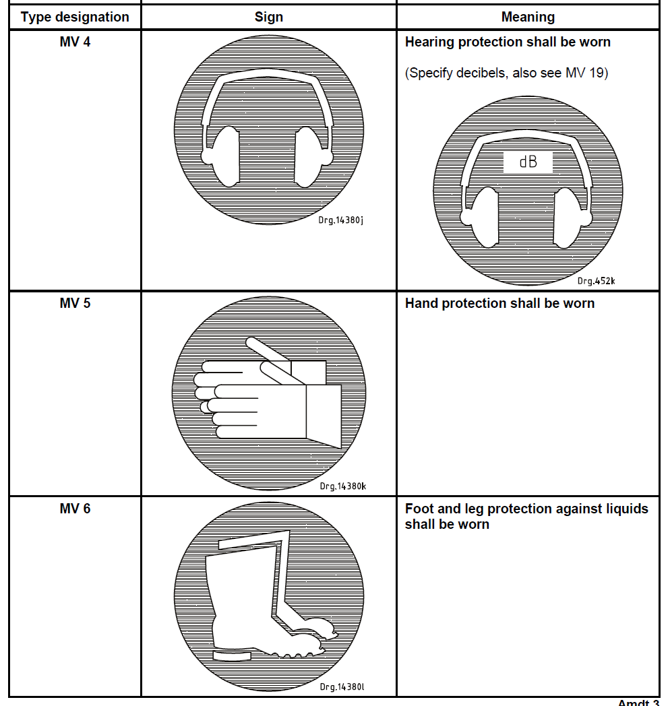
Clothing
Figures: Safety signs (SANS 1186-1)

Slide 14
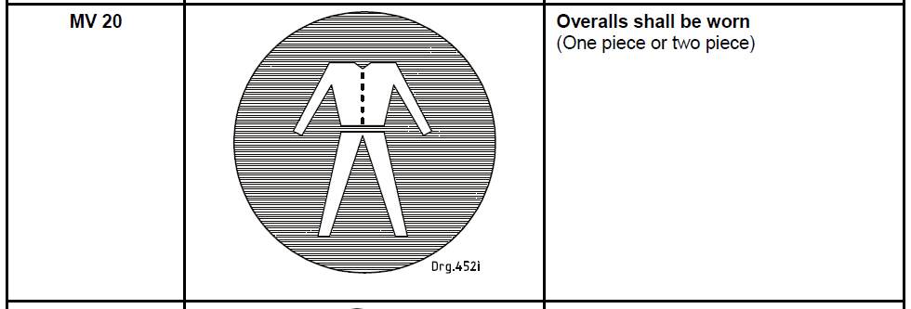
Clothing
Figures: Safety signs (SANS 1186-1)

Slide 15
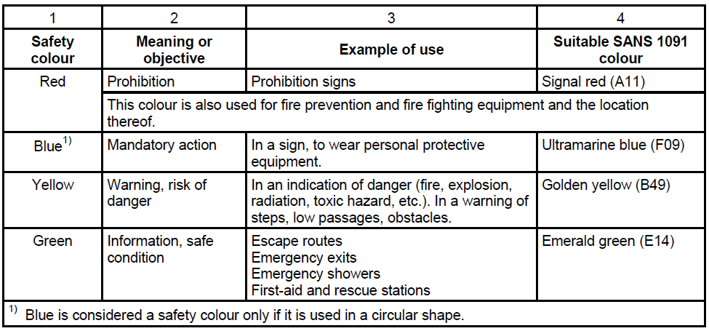
Symbols
Safety colours
Table 2 General meaning of safety colours (SANS 1186-1)

Slide 16
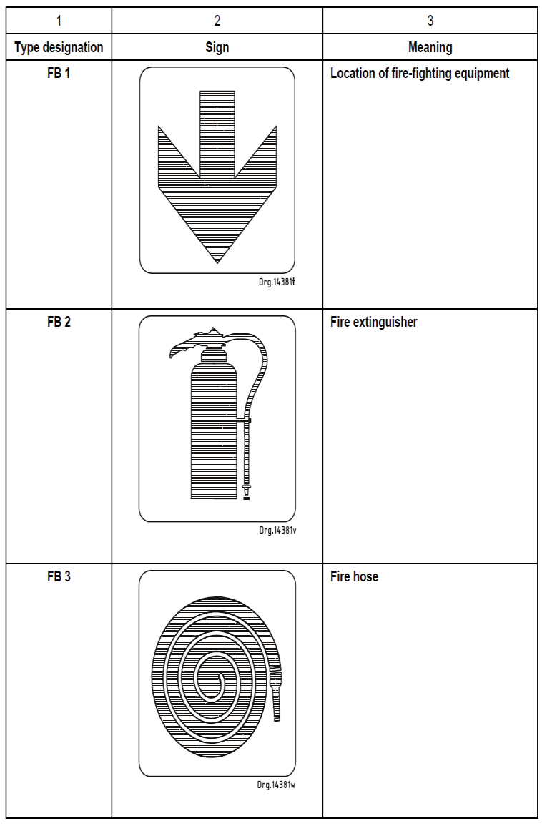
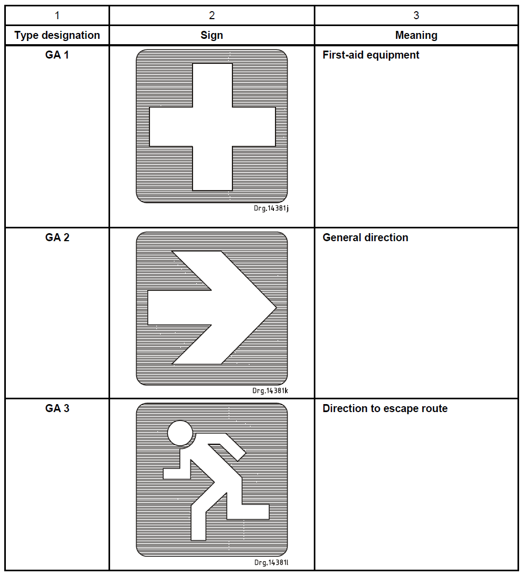
Symbols
Safety signs
Figures: Safety signs (SANS 1186-1)

Slide 17
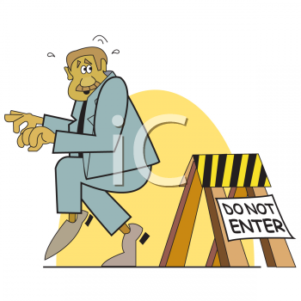
Symbols
Safety signs
Be responsible

Slide 18
Public liability
Liability to give relief in case of no fault (Act 6 of 1991)
Employers should be liable to give relief where death, injury or damage has resulted (Act 6 of 1991).
Duty of owner to take out insurance policies
Section 3(1) states that employers should be insured against liability to give relief and should take out insurance policies proving for contracts of insurance (Act 6 of 1991)
Application for claim for relief (Act 6 of 1991).
Application may be done by a person who has sustained injury, owner of property that has been damaged and representatives of the decreased person if death has resulted (Act 6 of 1991).

Slide 19
Public liability
Award of relief.
Section 4(2B) states that after the award has been made to the Collector, the insurer should pay within 30 days in the manner the Collector may direct (Act 6 of 1991).
A relief claim of death, injury or damage to a property should be paid as quickly as possible within the 30 days (Act 6 of 1991).
Right to claim compensation for death
Insurer or owner should be liable pay compensation with respect to any death (Act 6 of 1991).

Slide 20
Emergency preparedness
Emergency plan
Emergency plan can be based on different steps (Code of practice 2007).
Make a brief summary of job description and highlight measures identified on site
Make a list of emergency phone numbers to be available on site
Inform all employees about a rescue plan and a rescue personnel
Make sure that first aid kits are available
Discuss the plan and describe the standard safety requirements
Ensure that safety equipments such as fire detectors and extinguishers are in place

Slide 21
Emergency preparedness
First Aid
Regulation 3(1) of the General Safety Regulations states that, in a workplace of more than 5 employees the first aid kit shall be available and visible (Code of practice 2007).
Regulation 3(1) of the General Safety Regulations states that, in a workplace of more than 10 employees first aid competent person with valid certificate should always be in place and at least one personnel should have had first aid trainings (Code of practice 2007).
Rescue Methods
Employees should have trainings on rescue missions
Personnel involved in rescue attempt should be responsible for their safety
Rescued persons should be sent to the hospital immediately

Slide 22
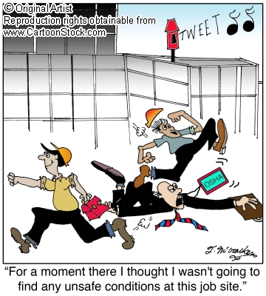
Emergency preparedness
Save your self
Run for your life!

Slide 23
Conclusion

Slide 24
References
South African institution of Civil Engineers (Geotechnical Division). (2007).The safety of persons working in small diameter shafts and test pits fro geotechnical engineering purposes: Code of practice 2007. First edition. South African institution of Civil Engineers: Halfway House. Pp. 1-44.
Ridley, J. and Channing, J. (1999). Workplace Safety. Volume 4 of the Safety at Work Series. Butterworth-Heinemann: Jordan Hill
Hutter, B.M. (2001). Regulation and Risk Occupational Health and Safety on the Railways:Part IV Consititutive Regulation? Risk and Compliance. Oxford University Press Inc. New York. Pp. 197-230.
Anglo Coal. (2008). Anglo Coal report to society 2008: Responsible and Sustainable mining. Place unknown. Publisher unknown. [Available from] http://www.angloamerican.com
Kassouf, P., Rosteck, J., Bartlett, M.L., Brawner, K.M., O’Donnell, T., Cook, R.F. and Irwin, G. (2011). Part 16 Risk Management: Reducing risk by incorporating lessons learned into the planning of the outfall tie-ins on the east side cso tunnel project in Portland, Oregon. In: Redmond, S. and Romero, V. Rapid Excavation and Tunneling Conference Proceedings. Society for Mining, Metallurgy, and Exploration, Inc. Englewood Colorado. Pp. 1107-1123.

Slide 25
Thank you

