Slide 1
Monod equation
Monod equation is a kinetic model which describes microbial growth as a functional relationship between the specific growth rate and an essential substrate concentration.
(Liu 2006)

Slide 2
Monod equation
$$\frac{1}{B}×\frac{dB}{dt}=μ=μ_{max}×\frac{S}{\left(K_{s}+S\right)}$$
Where:
B = concentration of bacteria degrading the substrate.
µ = Specific growth rate of bacteria
µ_{max} = Maximum value of specific growth rate
S = Concentration of limiting substrate or nutrients
K_{s} = Saturation constant, equal to the concentration of substrate giving growth rate of µ_{max}
(OECD 1995)

Slide 3
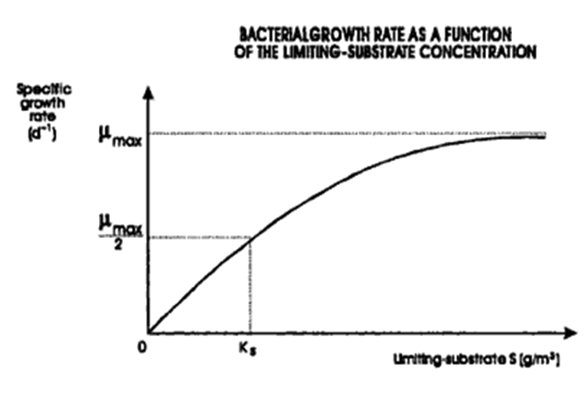
Application and importance
If the concentration of S is reduced, the population growth rate will decrease. If concentration of S increases to a specific limit where growth rate is maximum, then S is no longer regarded as a limiting factor.
When Ks = S the term S/(Ks + S) becomes half (1/2) and the growth rate becomes equal to ½ maximum rate.
Figure 1 is a graphic representation of Monod’s equation (Von Sperling and De Lemos Chernicharo 2005).
(Von Sperling and De Lemos Chernicharo 2005).

Slide 4
Application and importance
Monod equation is used to determine the amount of substrate removal in sewage treatment.
In sewage treatment, the limiting substrate is usually organic carbon and K is inversely proportional to the growth rate
To obtain high substrate removal, the K value of substrate has to be low.
The aim of Monod was to establish that bacterial growth rate was a function of the substrate concentration increase to a certain level where the rate of growth becomes constant with increased substrate concentrations.
(Von Sperling and De Lemos Chernicharo 2005).
(Mckenney 2004).

Slide 5
References
Liu, Y. (2006). Biochemical Engineering Journal: A simple thermodynamic approach for derivation of a general Monod equation for microbial growth. Division of Environmental and Water Resource Engineering: Singapore. Vol 31: pp-102-105
McKenney, R.E. (2004). Environmental pollution control microbiology. Marcel Dekker, Inc. USA
OECD. (1995). OECD guidelines for testing of chemicals Section 4: Other test guidelines. Environmental monographs series: France
Von Sperling, M. And De Lemos Chernicharo, C.A.(2005). Biological wastewater treatment in warm climate regions. IWA: UK. Vol 1. Pp-1460

